Slide 1
Genome signal prediction enhancer or not

Slide 2
Problem statement
To predict the genome signal is enhancer or not by using machine learning algorithm - Artificial Neural Networks.

Slide 3
motivation
Enhancer is a sequence of DNA that works to enchance or speed up the rate of genetic transcriptions. To increase the genetic transcriptions classifying enhancer is important.
This area of research could be so useful because the genome transcriptions of specific kind are significantly responsible for diseases like cancer.

Slide 4
introduction
Enhancer : Enhancers are noncoding fragments in DNA sequences, which play an important role in gene transcription and translation. Enhancers are a small area of DNA that can link with protein, located upstream or downstream of the gene, and gene transcription will be enhanced after they bind with protein.
The Central Dogma of Molecular Biology states that DNA makes RNA makes proteins .The process by which DNA is copied to RNA is called transcription, and that by which RNA is used to produce proteins is called translation.

Slide 5
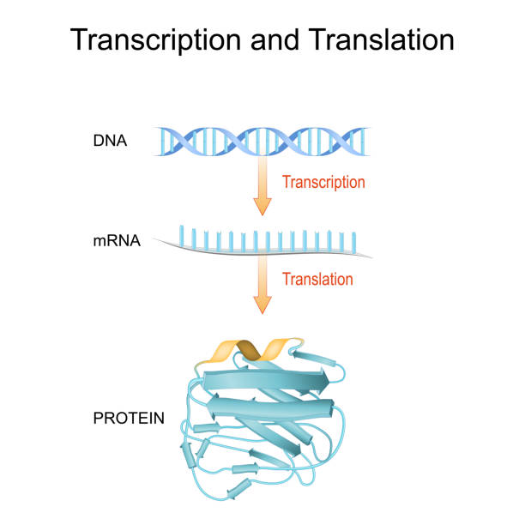

Slide 6
3.1.REQUIREMENT SPECIFICATION
REQUIREMENT SPECIFICATION
FUNTIONAL REQUIREMENTS
ENHANCER DATA OF THE GENOME SIGNAL
USER - BIO INFORMATION ANALYST
NON FUNCTIONAL REQUIREMENTS
A SYSTEM TO RUN ANN OF PYTHON
DATASET OF ACGT ENHANCER SEQUENCES
PIP LIBRARIES OF KERAS,TENSORFLOW,NUMPY, SKLEARN,SGBOOST.

Slide 7
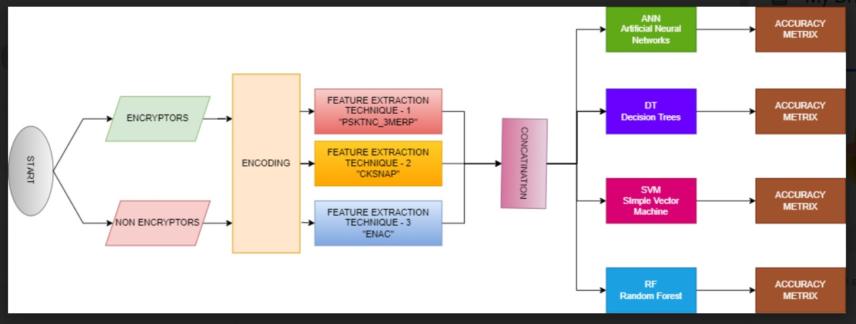
FLOW CHART
enchancers
Non
enchancers

Slide 8
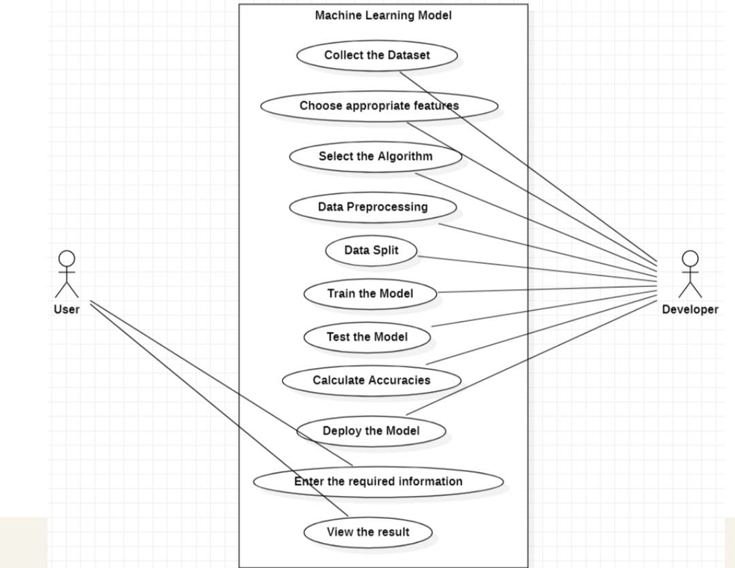
UML DIAGRAM

Slide 9
description
Our proposed system is genome signal predictor using machine learning techniques. In our model we aim to predict the given gene expression is enhancer or not.
It comes under binary classification type of machine learning model because, we are predicting whether the given gene expression is enhancer or not.
For this, we use different machine learning algorithms like ANN(Artificial neural networks),SVM(Support vector machine),decision trees,Random forest classifier to find the best accuracy.

Slide 10
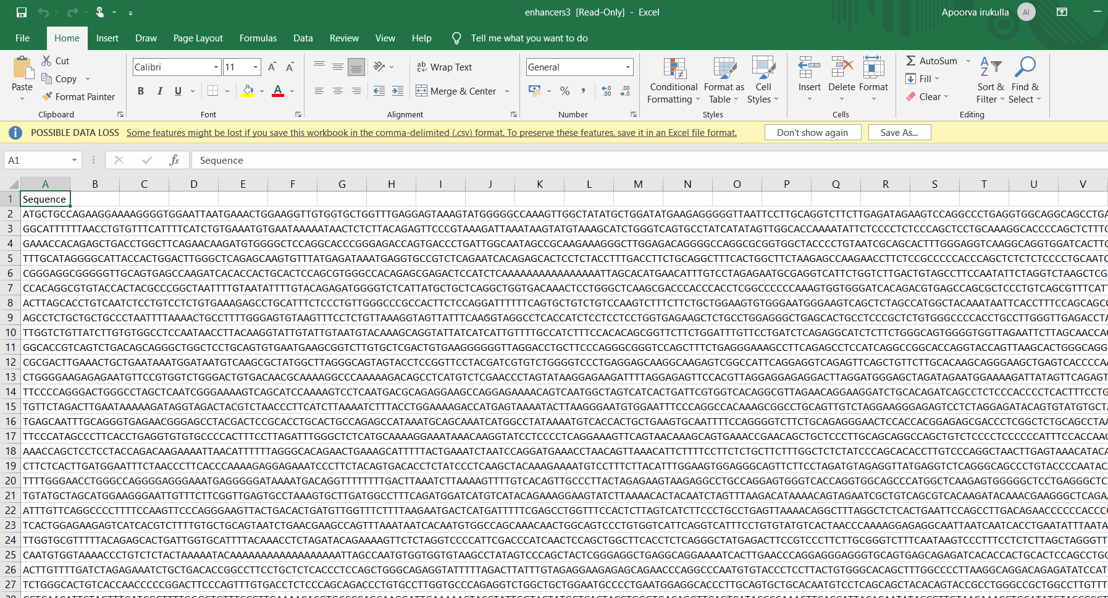
DATASET
We have worked on 1484 Enhancer ACGT sequences of benchmark dataset of enhancers and non enhancers, a total of 2968 samples.

Slide 11
Feature extraction techniques
Machine learning algorithms cannot directly perform annotations on continuous nucleotide sequences, so it is necessary to convert nucleotide sequences represented by strings into feature vectors.
We have tried various feature extraction techniques like Kmer, RCKmer, ENAC, CKSNAP, NAC, DNC, TNC,ANF, NCP, etc.,
We have used these three feature extraction techniques CKSNAP,ENAC,PSTKNC_3MERP(position specific tendencies if k-mer nucleotide composition)

Slide 12
Composition of K-Spaced Nucleic Acid Pairs (CKSNAP): This method calculated the frequency of pairs of nucleotides separated by K nucleotides in the whole sequence. When , it is consistent with the features represented by 2-mer. It should be noted that the frequency of nucleotide pairs is calculated when k= 1, 2, 3, 4, and 5, the length of sequences should be L-1, L-2, L-3, L-4, L-5, and L-6.
Enhanced Nucleic Acid Composition (ENAC): Enhanced nucleic acid composition is the frequency of each nucleotide occurring within a fixed sequence window length, which slides continuously from the 5’ end to the 3’ end of each nucleotide sequence and usually used to encode nucleotide sequences of the same length.

Slide 13
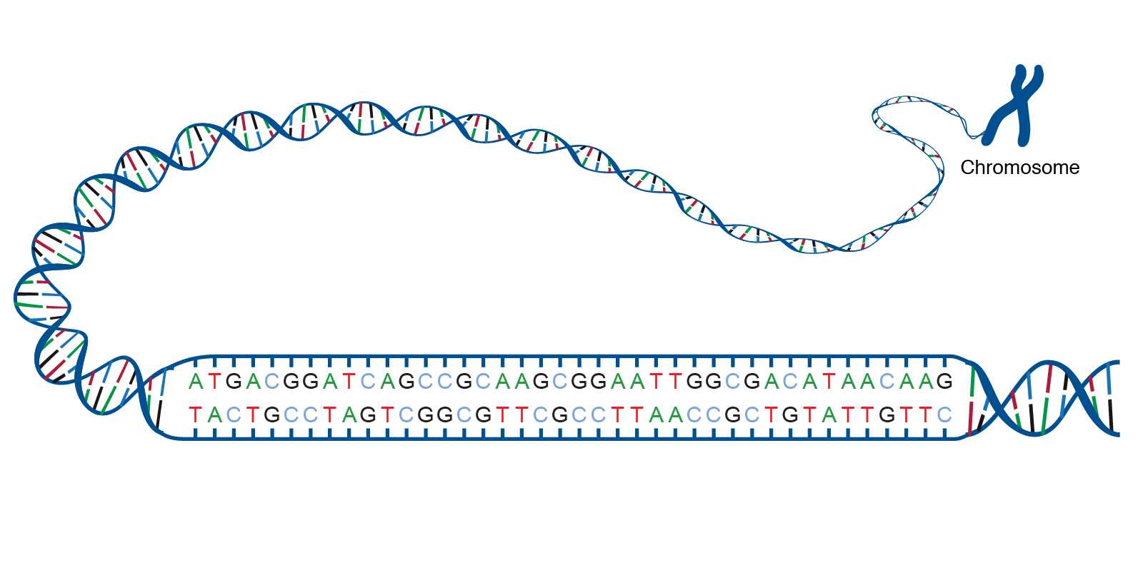
TEST CASES
ACGT seaquences of enhaners or ACGT sequences of DNA belonging to cis - regulatory site : Enchancer.
ACGT is an acronym for the four types of bases found in a DNA molecule: adenine (A), cytosine (C), guanine (G), and thymine (T). A DNA molecule consists of two strands wound around each other, with each strand held together by bonds between the bases. Adenine pairs with thymine, and cytosine pairs with guanine. The sequence of bases in a portion of a DNA molecule, called a gene, carries the instructions needed to assemble a protein.
we have done our research on 1484 enhancer and non enhancer pairs.

Slide 14
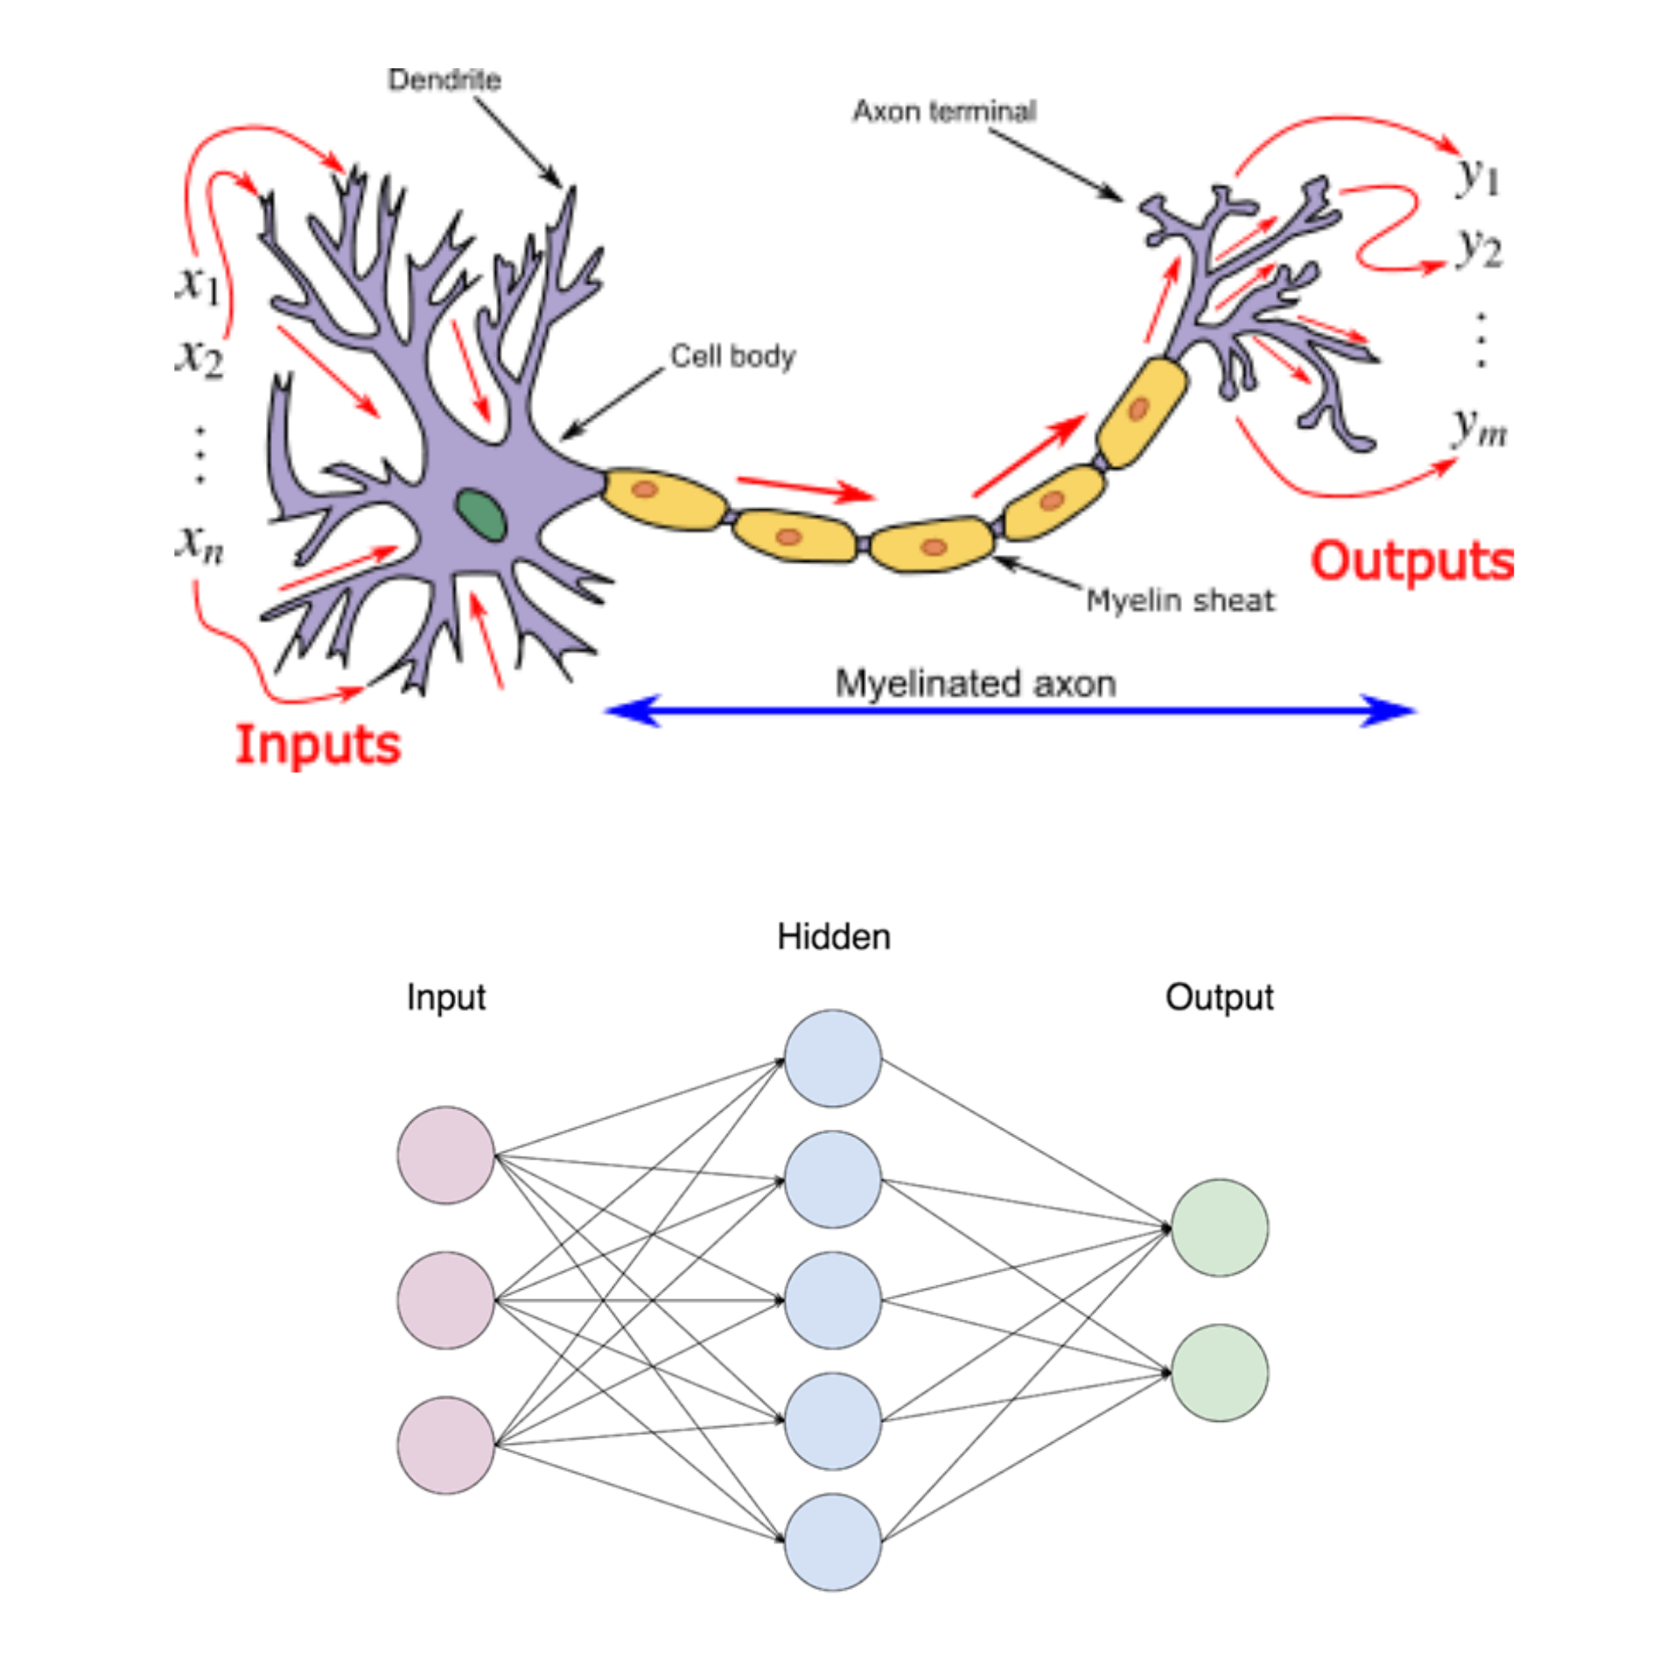
OVERVIEW TECHNOLOGY
Artificial Neural Network ANN is an efficient computing system for
MULTICLASS CLASSIFICATION
ANN is highly recomanded for complex problems of Multi-class classification, which is the task of classifying elements into different classes. Unlike binary, it doesn’t restrict itself to any number of classes.
central theme is borrowed from the analogy of biological neural networks.
ANNs are also named as “artificial neural systems,” or “parallel distributed processing systems,” or “connectionist systems.”
We have deployed our model using ANN and optimizer adam, loss funnction of binary entropy, activation function of RELU and soft max output function and predicts the result using binary classification.
nary classification.

Slide 15
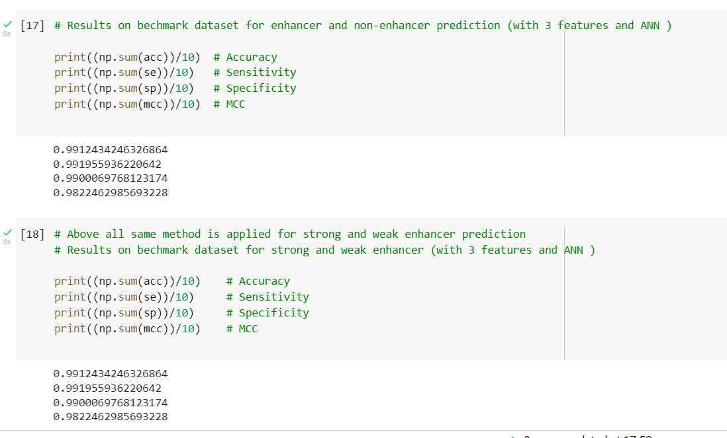
RESULTS
Our model accounts for a whopping accuracy of 99% when applied for Enhancer dataset file containing benchmark dataset of enhancers.

Slide 16
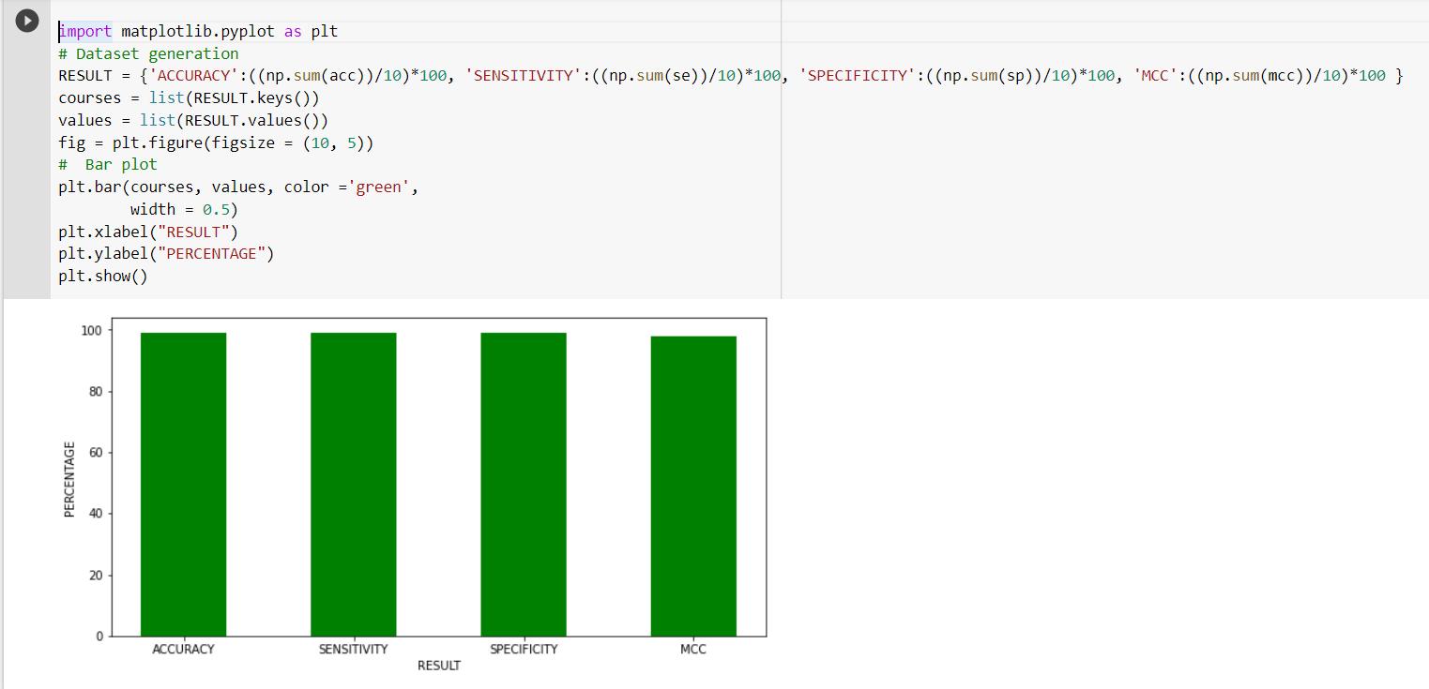
RESULTS

Slide 17
conclusion
Therefore, genome signal prediction using machine learning is efficient and accurate to predict the genome pattern. Bio informatics gives a good scope to relate the concepts of biology to Artificial intelligence to personalize various aspects of gene sequencing predictions.
Similarly, genome signal prediction works by applying various concept of Artificial Neural network (ANN) algorithm on the genome pattern to give out the transcription factor site prediction for enhancers. Our project has future scope to study how and why enhancers function to synthesize the RNA to determine various structural and functional elements of body's growth and development.

Slide 18
FUTURE SCOPE
Our project has future scope to study how and why enhancers function to synthesize the RNA to determine various structural and functional elements of body's growth and development.
This can be further incorporated for promotors too.
This area of research could be so useful to understand genome transcriptions of specific kind which are significantly responsible for diseases like cancer and paralysis.
Useful for practical laboratory synthesis of protein by enhancer binding of specific kind and functionality.

